Slide 1
FOOD IS FREE CARNOUSTIE
fifcarnoustie@gmail.com
#FoodIsFree Carnoustie
Notes:
Welcome, introductions, running order

Slide 2
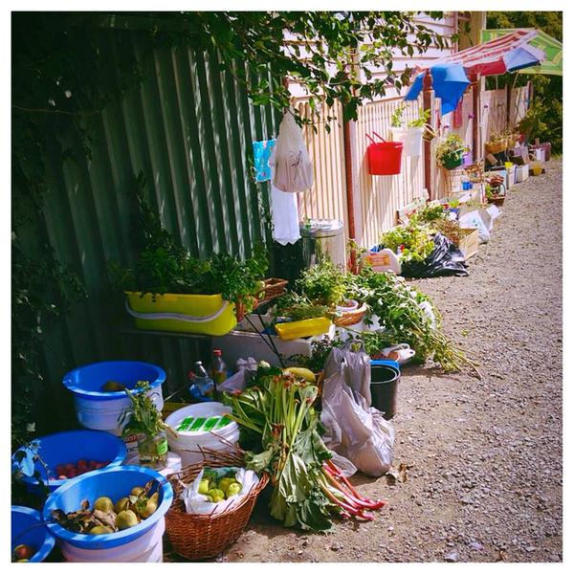
WHAT IS FOOD IS FREE?
Community building and garden
movement
Launched in January 2012 in Austin, Texas
From one front garden to a global
movement
www.foodisfreeproject.org
Notes:
Food Is Free started in 2012 in Austin, Texas and grew into a community building and garden movement.
One person turned over their front garden to growing fruit and vegetables and within 3 months most other houses in the street were doing the same. Any surplus that was grown was shared within the community.
In 3 years Food Is Free has become global with people from America to Australia becoming involved. There are over 190 cities involved in Food Is Free Projects and not only individuals but many community groups, schools and churches are taking part. The picture here shows the Laneway, Ballarat in Melbourne, Australia.
The ethos behind Food Is Free bring communities together, educate on where food comes from and reuse and recycle where possible.

Slide 3
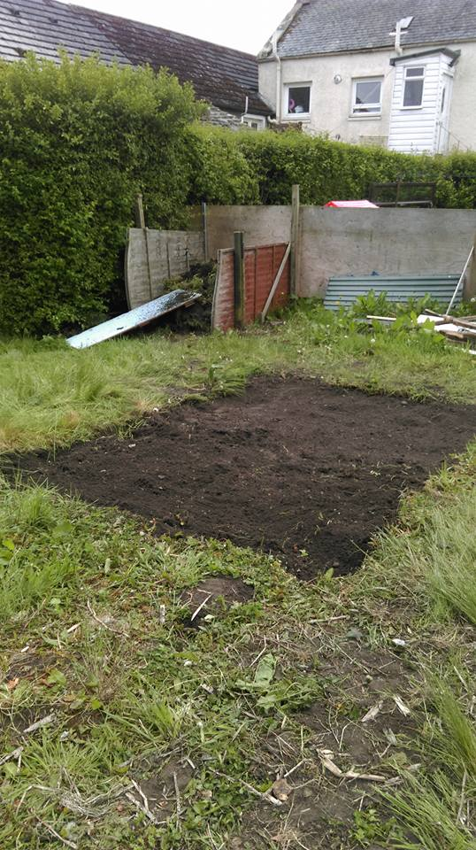
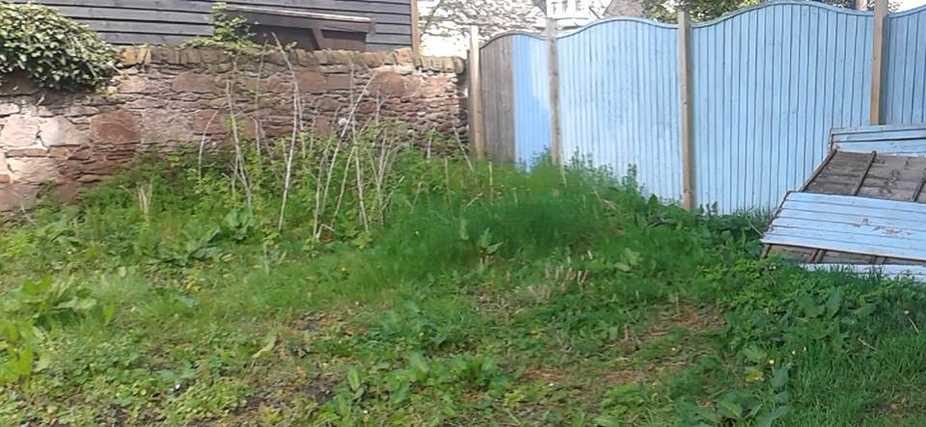
FIF CARNOUSTIE - THE BEGINNING
Notes:
Back in April we heard about the Food Is Free Project through Common Weal Angus. One of their members had set up Arbroath Food Is Free and spoke at one of the meetings about it. This inspired us to try and create something similar in Carnoustie. We wanted to create a community sharing network by working with other local community groups and sharing the produce grown in community areas and private spaces with the people of Carnoustie.
We were kindly donated the use of some land by Robin Rainer which we began work on in late May. It was all a bit of a rush to get the ground ready and plants in as it was quiet late in the season for planting summer fruit and veg.
Set up compost bin, dug 4 beds, set up a polytunnel and were donated tools and equipment from various folk. Also, donated seedlings and seeds from Arbroath Food Is Free.
We also set up a facebook group page to get more volunteers and supporters. Currenty 136 members of the group on facebook.

Slide 4
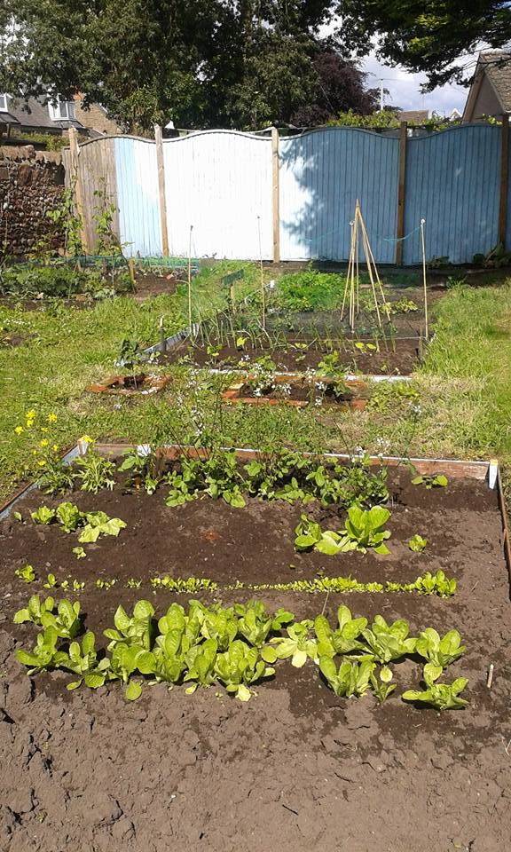
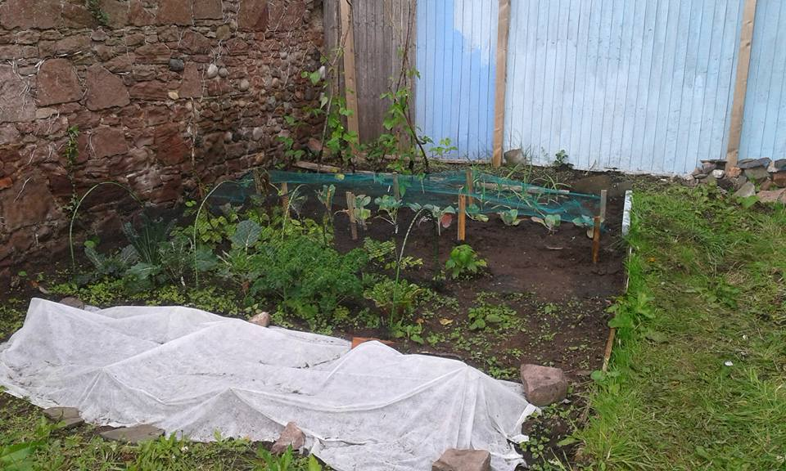
Notes:
Planted beans, broad beans, kale, beetroot, carrots, various herbs, rocket, lettuce, courgette, sweetcorn and tomatoes, peppers, chillis in the polytunnel

Slide 5
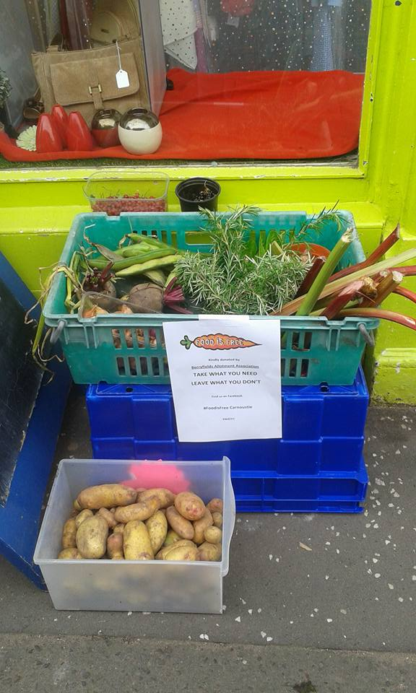
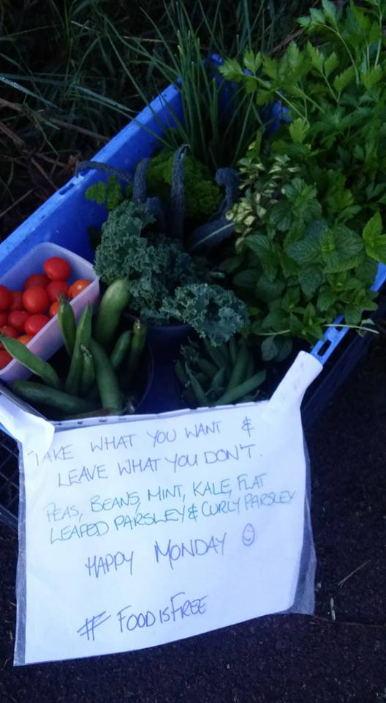
Notes:
boxes so far. For Carnoustie, The Haven, cycle path at west end of town

Slide 6
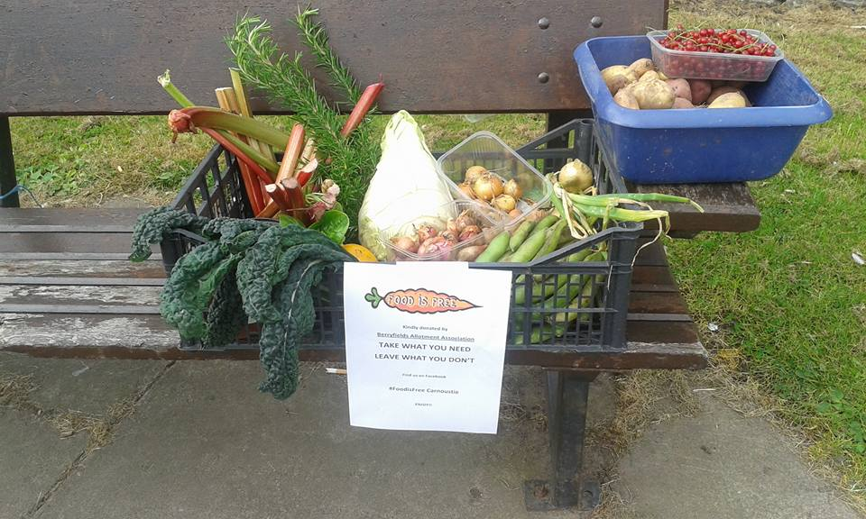
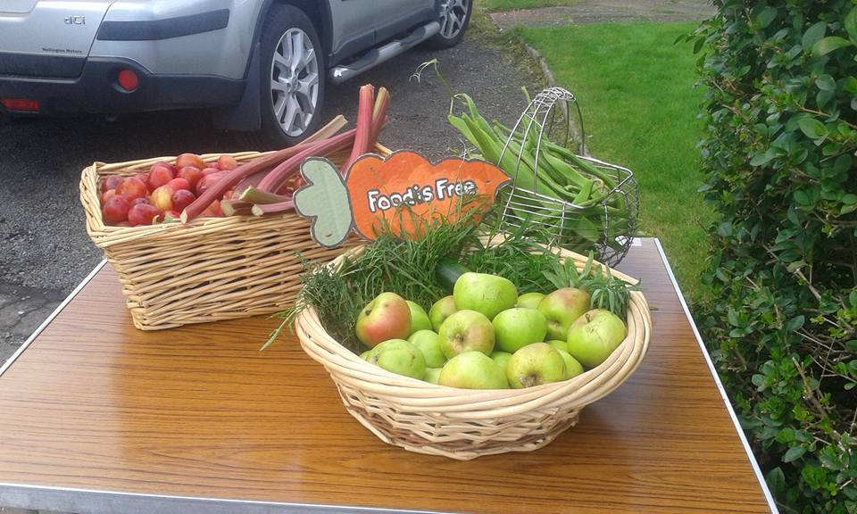
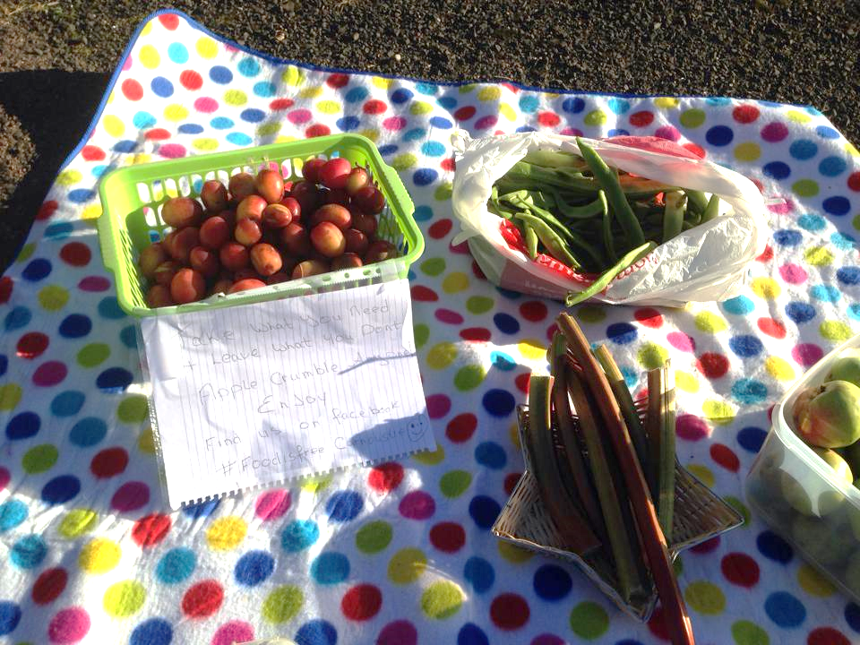
Notes:
Spar on Barry Rd, Carnoustie House Grounds, Panmure Centre and Panbride Church
Most fruit and veg is taken. Learning as we go along to say what is in the boxes as found that if people didn’t know what it was it wouldn’t get taken. Also thinking about next year of adding recipes as some people commented they weren’t sure what to do with certain things.

Slide 7
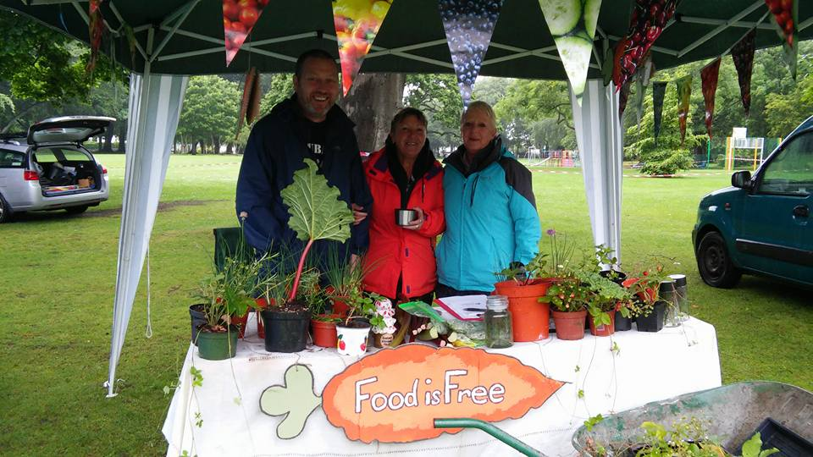
COMMUNITY
GALA DAY
COLOURFUL CARNOUSTIE
MENS SHED
OUR EASTHAVEN
BERRYFIELDS ALLOTMENT
ASSOCIATION
ANGUS COUNCIL
FOR CARNOUSTIE
Notes:
One of our main aims was to forge links with other community groups. We had a stall at gala day to help spread the word and offer free fruit and veg plus plants. We were delighted to be asked by Colourful Carnoustie to be included in the Carnoustie entrant for the Keep Scotland Beautiful Award and plan to do some joint projects together next year. The Men’s Shed is another new group that has started this year and they are working on building some wooden planters for us and using some of the space at the Panmure centre to grow some veg. The wood for the planters was kindly donated by the Wellcome Trust Farm and the lining was old quarry bags donated by Cotside Quarry. We have also visited Our Easthaven to take a look at what they have been doing and get some advice on how to progress as a group. Berryfields Allotments have kindly offered us the use of their community beds up at Maule St. Both For Carnoustie and the Gala Committiee have been very generous and given us some funds for the coming year to expand the project. We have also been in contact with Angus Council to see if there are any bits of land that would be suitable for us to use. Thank you to everyone in the community who has been enthusiastic and supportive of what we have been doing.
Hand over to Laura – inspirations and benefits

Slide 8
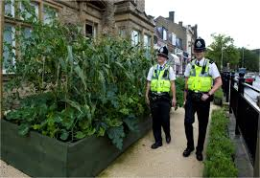
INCREDIBLE EDIBLE
Started in Todmorden, Yorkshire in 2007.
100 groups in UK and global groups in Canada and New Zealand
If you eat – you are in!
3 Plates philosophy
Community Plate
Learning Plate
Business Plate
www.incredibleediblenetwork.org.uk
Notes:
Incredible Edible Todmorden was started in 2007 as a small herb garden and has grown into a network of 100 Incredible Edible groups across the UK, including some in Scotland at Dumfries, Dunbar and Gatehouse. They are also global with groups in Canada, Australia, US and France. We love their philosophy of membership of Incredible Edible – If you eat, you are in! They believe in a strong community and found that food was the answer. Everyone understands food. Food could get people talking; even better, it could inspire people to take action.
The Community Plate – growing produce and working together. How ordinary people can transform their local landscape and turn areas over to growing local food. Working with public bodies such as police, health service, schools, local council, and fire services to grow food around the town. Learning Plate – getting people to learn about fresh, healthy locally grown food. Work with schools , create garening clubs, training courses and workshops. Helps grow next generation and creates and interest in community.BusinessPlate – create a local food economy. Promote small local food business. IE used blackboards for shops and market stall to promote local food this lead to questions and more sales. Created green route through gardens, shops and cafes.
Benefits – low crime, tourism, sense of community

Slide 9
FUTURE PLANS AND IDEAS
Areas for growing/growing the area
Fruit exchange/fruit map
Seed exchange
Working with local business
Working with community groups
Other skills
Community events

Slide 10
HOW WILL WE WORK
COMMITTEE
PROJECT 1
PROJECT 2
PROJECT 3

Slide 11
KINLOCH STREET AREA

Slide 12
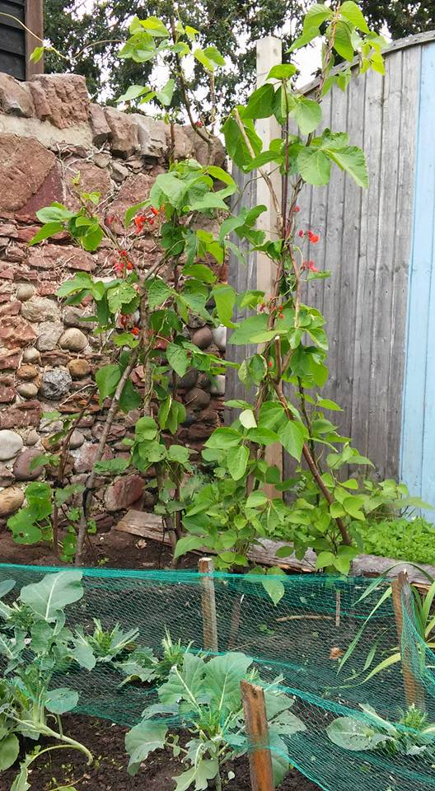
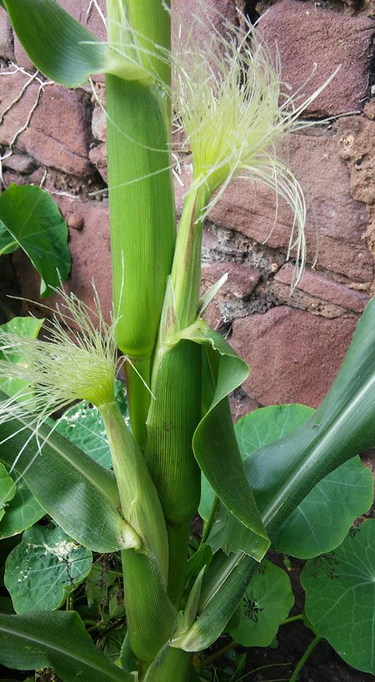
Question and Answers Ideas and Suggestions

